Slide 1
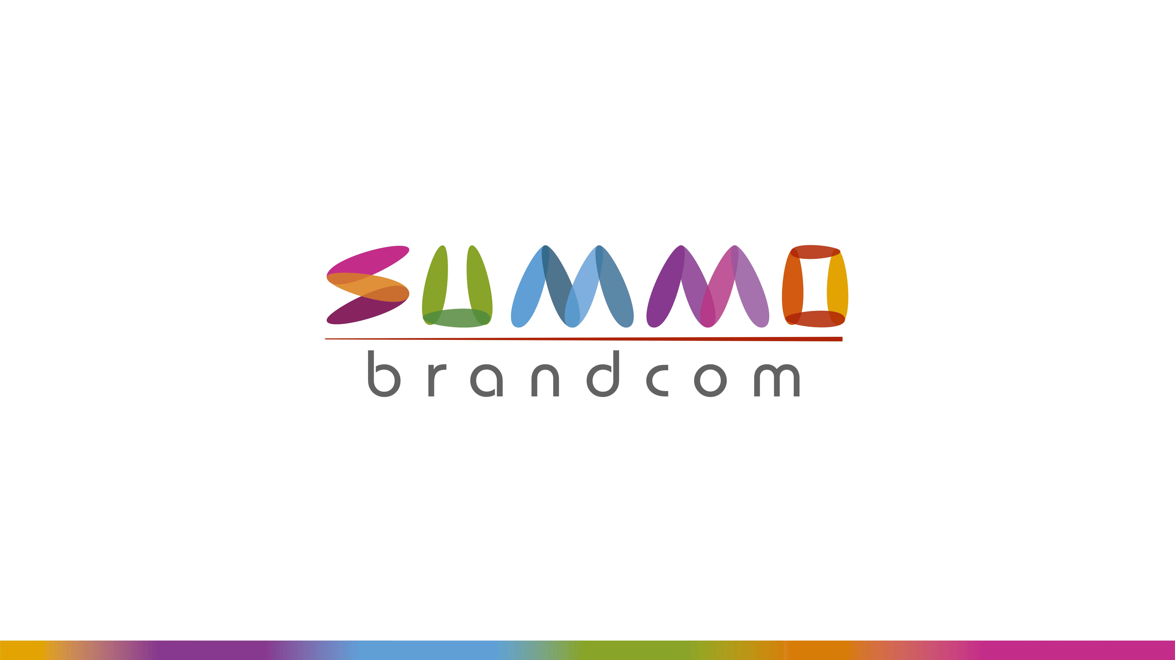

Slide 2

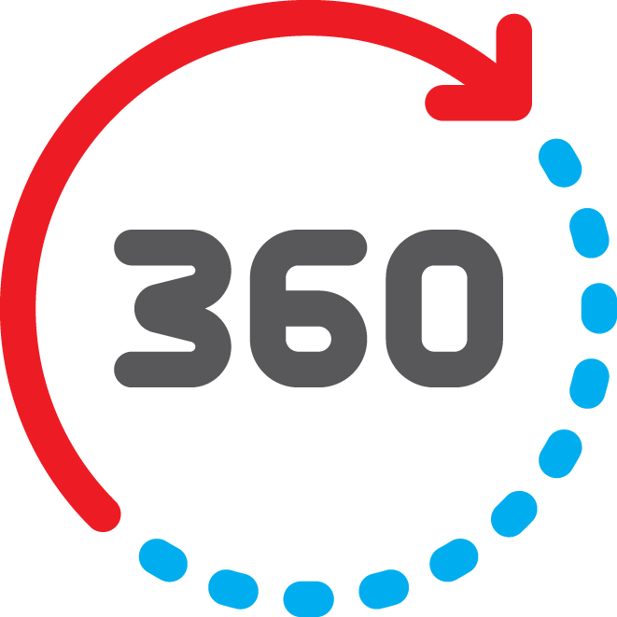
About Us :
A full fledged 360 degree media advertising agency head quartered in Mumbai, Summo Brandcom is the perennial flow of fresh ideas that sifts through the consumer values, needs and beliefs to communicate messages that propel the brand towards the target audience.
Summo Brandcom offers your brand all media solutions including Media Planning & Buying, Digital Marketing, Ambient Media solutions, Experiential Marketing, Retail Management & Print Production.
Our partnership with clients in strategic communication to bringing long term advantage for their brands and the organization has not only given positive results but has also cemented our relationship. Breaking away from the conventional Ad Agency set up, we are also offering Social Media and Online Marketing with Website Design and Development SEO and SEM services.

Slide 3

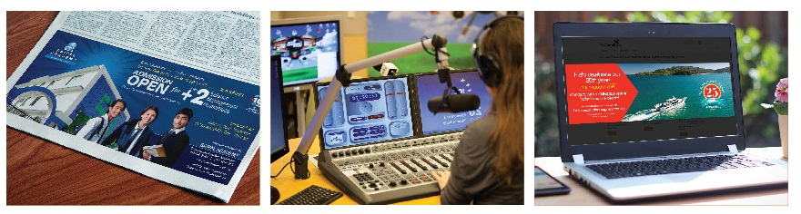
Media Management :
When it comes to gaining exposure, it's the right kind of exposure that matters. At Seven Islands, we ensure that your campaigns reach out to the right target audiences, through the right mediums. Be it television, radio, print, outdoor or digital, we formulate the most effective media mixes and we manage and monitor them as well.

Slide 4

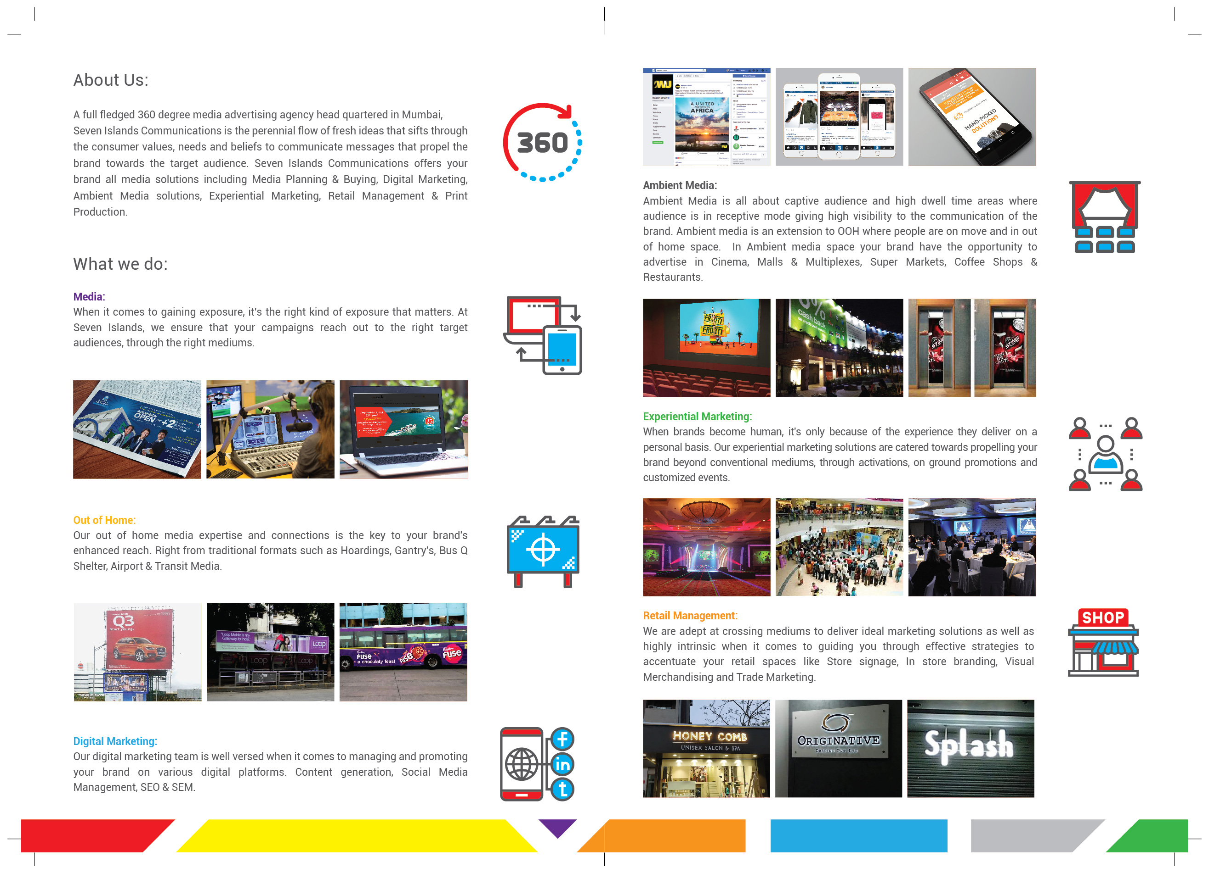
Out of Home :
We also specialize in impressions that can't be quantified. Our out of home media expertise and connections is the key to your brand's enhanced reach. Right from traditional formats such as Hoardings, Gantry's, Bus Q Shelter, Airport & Railway Stations, we're well versed when it comes to conceptualizing and executing various outdoor campaigns and out of home installations.

Slide 5

Ambient Media :
Ambient Media is all about captive audience and high dwell time areas where audience is in receptive mode giving high visibility to the communication of the brand. Ambient media is an extension to OOH where people are on move and in out of home space. In Ambient media space your brand have the opportunity to advertise in Cinema, Malls & Multiplexes, Super Markets, Coffee Shops & Restaurants.

Slide 6

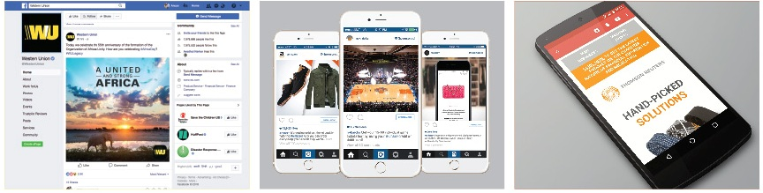
Digital Marketing :
Our digital marketing team is well versed when it comes to managing and promoting your brand on various digital platforms. Content generation, Social Media Management, Search Engine Optimization, Search Engine Marketing, managing your websites, Instagram handles and Youtube channels are some of the services on our digital platter.

Slide 7

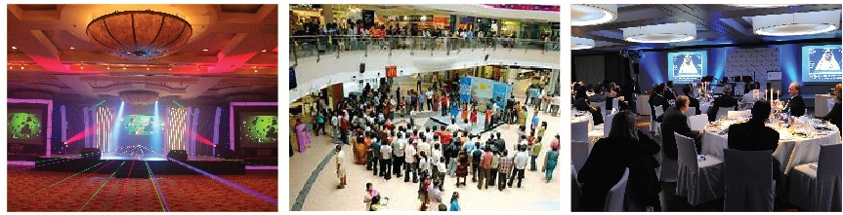
Experiential Marketing :
When brands become human, it's only because of the experience they deliver on a personal basis. Our experiential marketing solutions are catered towards propelling your brand beyond conventional mediums, through activations, on ground promotions and customized events. Creating optimum engagement is what we do best, and no better way than connecting directly to those who matter.

Slide 8

Retail Management :
We are adept at crossing mediums to deliver ideal marketing solutions as well as highly intrinsic when it comes to guiding you through effective strategies to accentuate your retail spaces. Our Store Design, Signage, Visual Merchandising & Trade Marketing expertise will only heighten your customer's experience and leave an impression that will trigger them to come back for more.

Slide 9

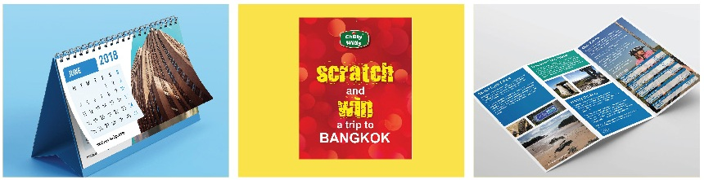
Print Production :
From print, to audio to film, we attain the right partners to work with us when it comes to executing your specialized campaigns. With utmost quality being maintained in the pre-production stages, we execute intricate supervision and meticulous planning in the post production aspects as well - carefully managing and delivering only the best output through the most efficient minds in the industry.

Slide 10

